Slide 1
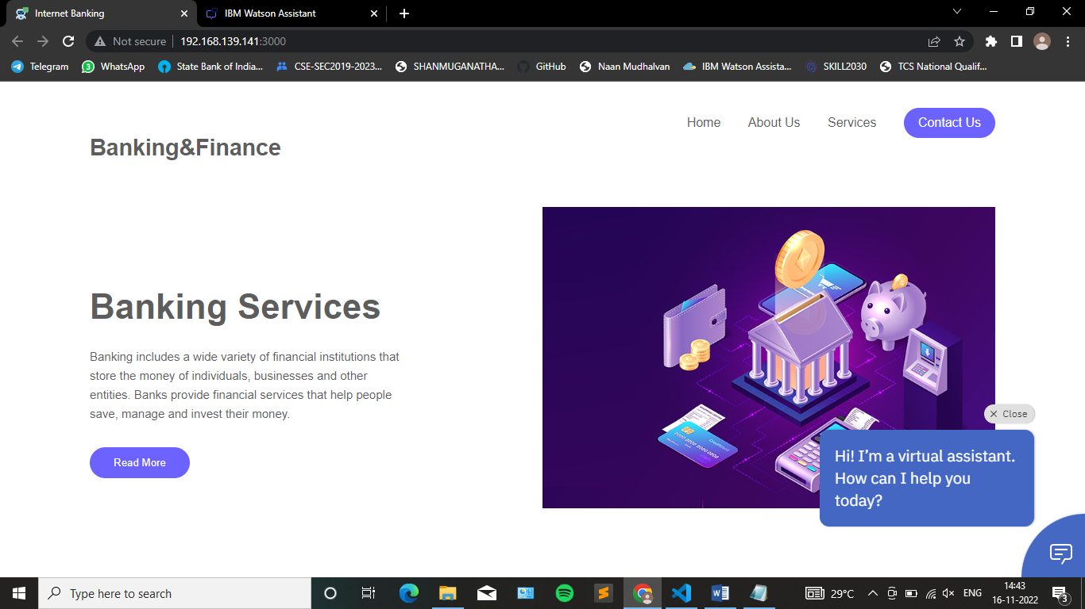
AI BASED DISCOURSE FOR BANKING INDUSTRY
SHANMUGANATHAN ENGINEERING COLLEGE
Department of Computer Science and Engineering
TEAM ID: PNT2022TMID48085
NAME: M. Muthukumar
REG.NO: 912419104019

Slide 2
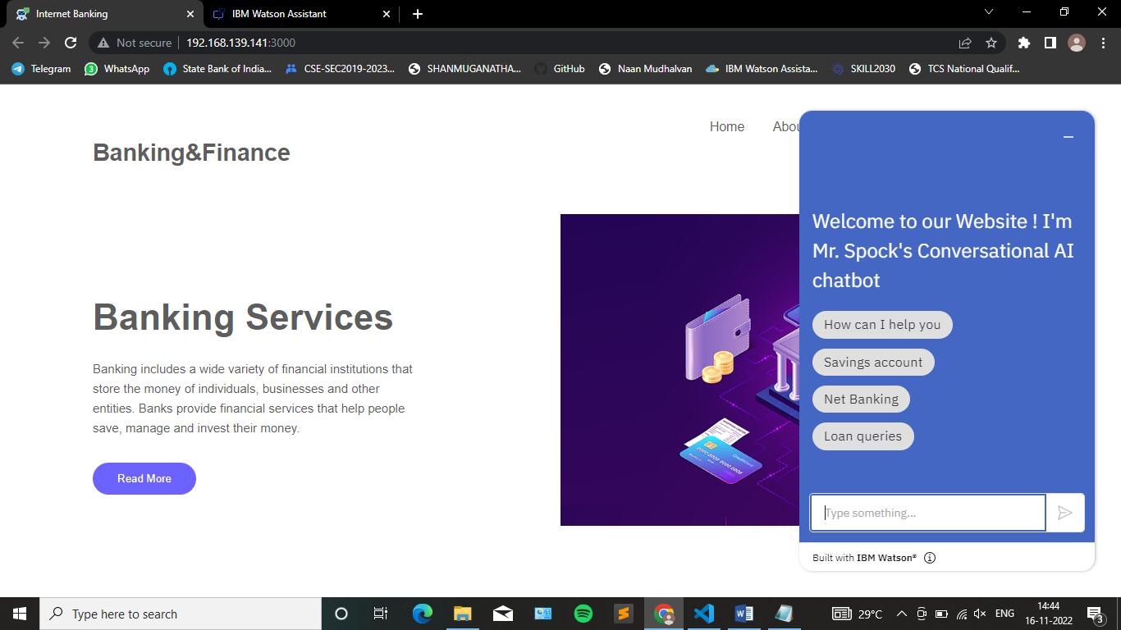
TECHNOLOGY & DOMAIN
Artificial Intelligence
Domain : Banking & Finance

Slide 3

OBJECTVE
Chatbot can be created the services Savings account action, Current account action, loan account action, general queries and net banking related queries.

Slide 4

ABSTRACT
Chat robot, a computer program that simulates human conversation, or chat, through artificial intelligence an intelligence chat bot will be used to give information.
User asked the queries to chatbot then answer the queries.

Slide 5
LITERATURE SURVEY
BANKING WITH A CHATBOT – A STUDY ON TECHNOLOGY ACCEPTANCE
Author - Mónika-Anetta ALT, Ibolya VIZELI , Zsuzsa SĂPLĂCAN
Babeş-Bolyai University, Romania.
Releasing Year- Published Online: 12 May 2021, Volume & Issue: Volume 66 (2021) - Issue 1 (April 2021)

Slide 6
EXISTING SOLUTION
It further mentions how the banking industry has moved to use chatbots for providing an interface to customers so that they can have an assistant throughout the day for service.
The implementation of chatbot technology is evolving rapidly in the banking industry, yet customer acceptance is behind.

Slide 7
DISADVANTAGE
Questions must be programmed beforehand.
Impersonal
Must keep information up-to-date.
Technology issues.
Needs additional measures to protect identities

Slide 8
PROPOSED SOLUTION
It provides the seamless customer service. Reduced cost for customer support. Saves the customer time/ It Provide the exceptional customer service at 24/7 available and multiple languages.
chatbot has features like no code deployment, omnichannel messaging support, fall back options, sentiment analysis to add value to conversations.

Slide 9
ADVANTAGE
The bot makes user feel that they are interacting with a human being.
The bot answers very quickly.
The system is easy to understand and handle.
The intelligent system understands user’s queries and answers quickly.

Slide 10
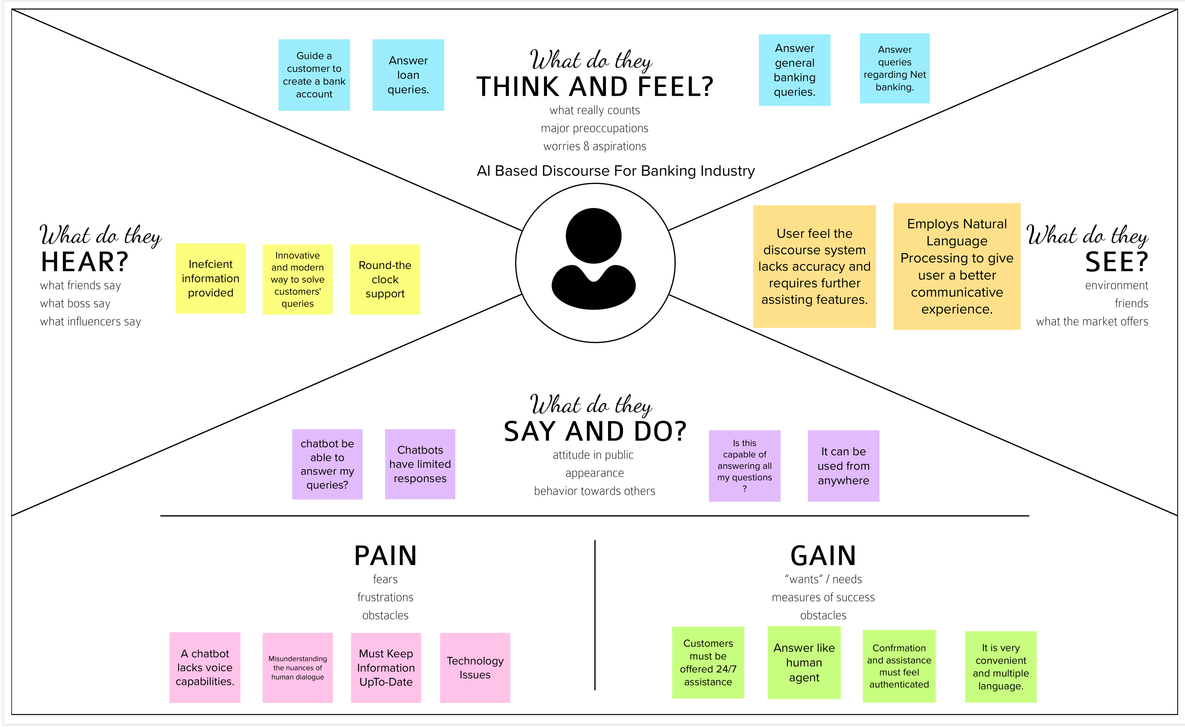
EMPATHY MAP

Slide 11
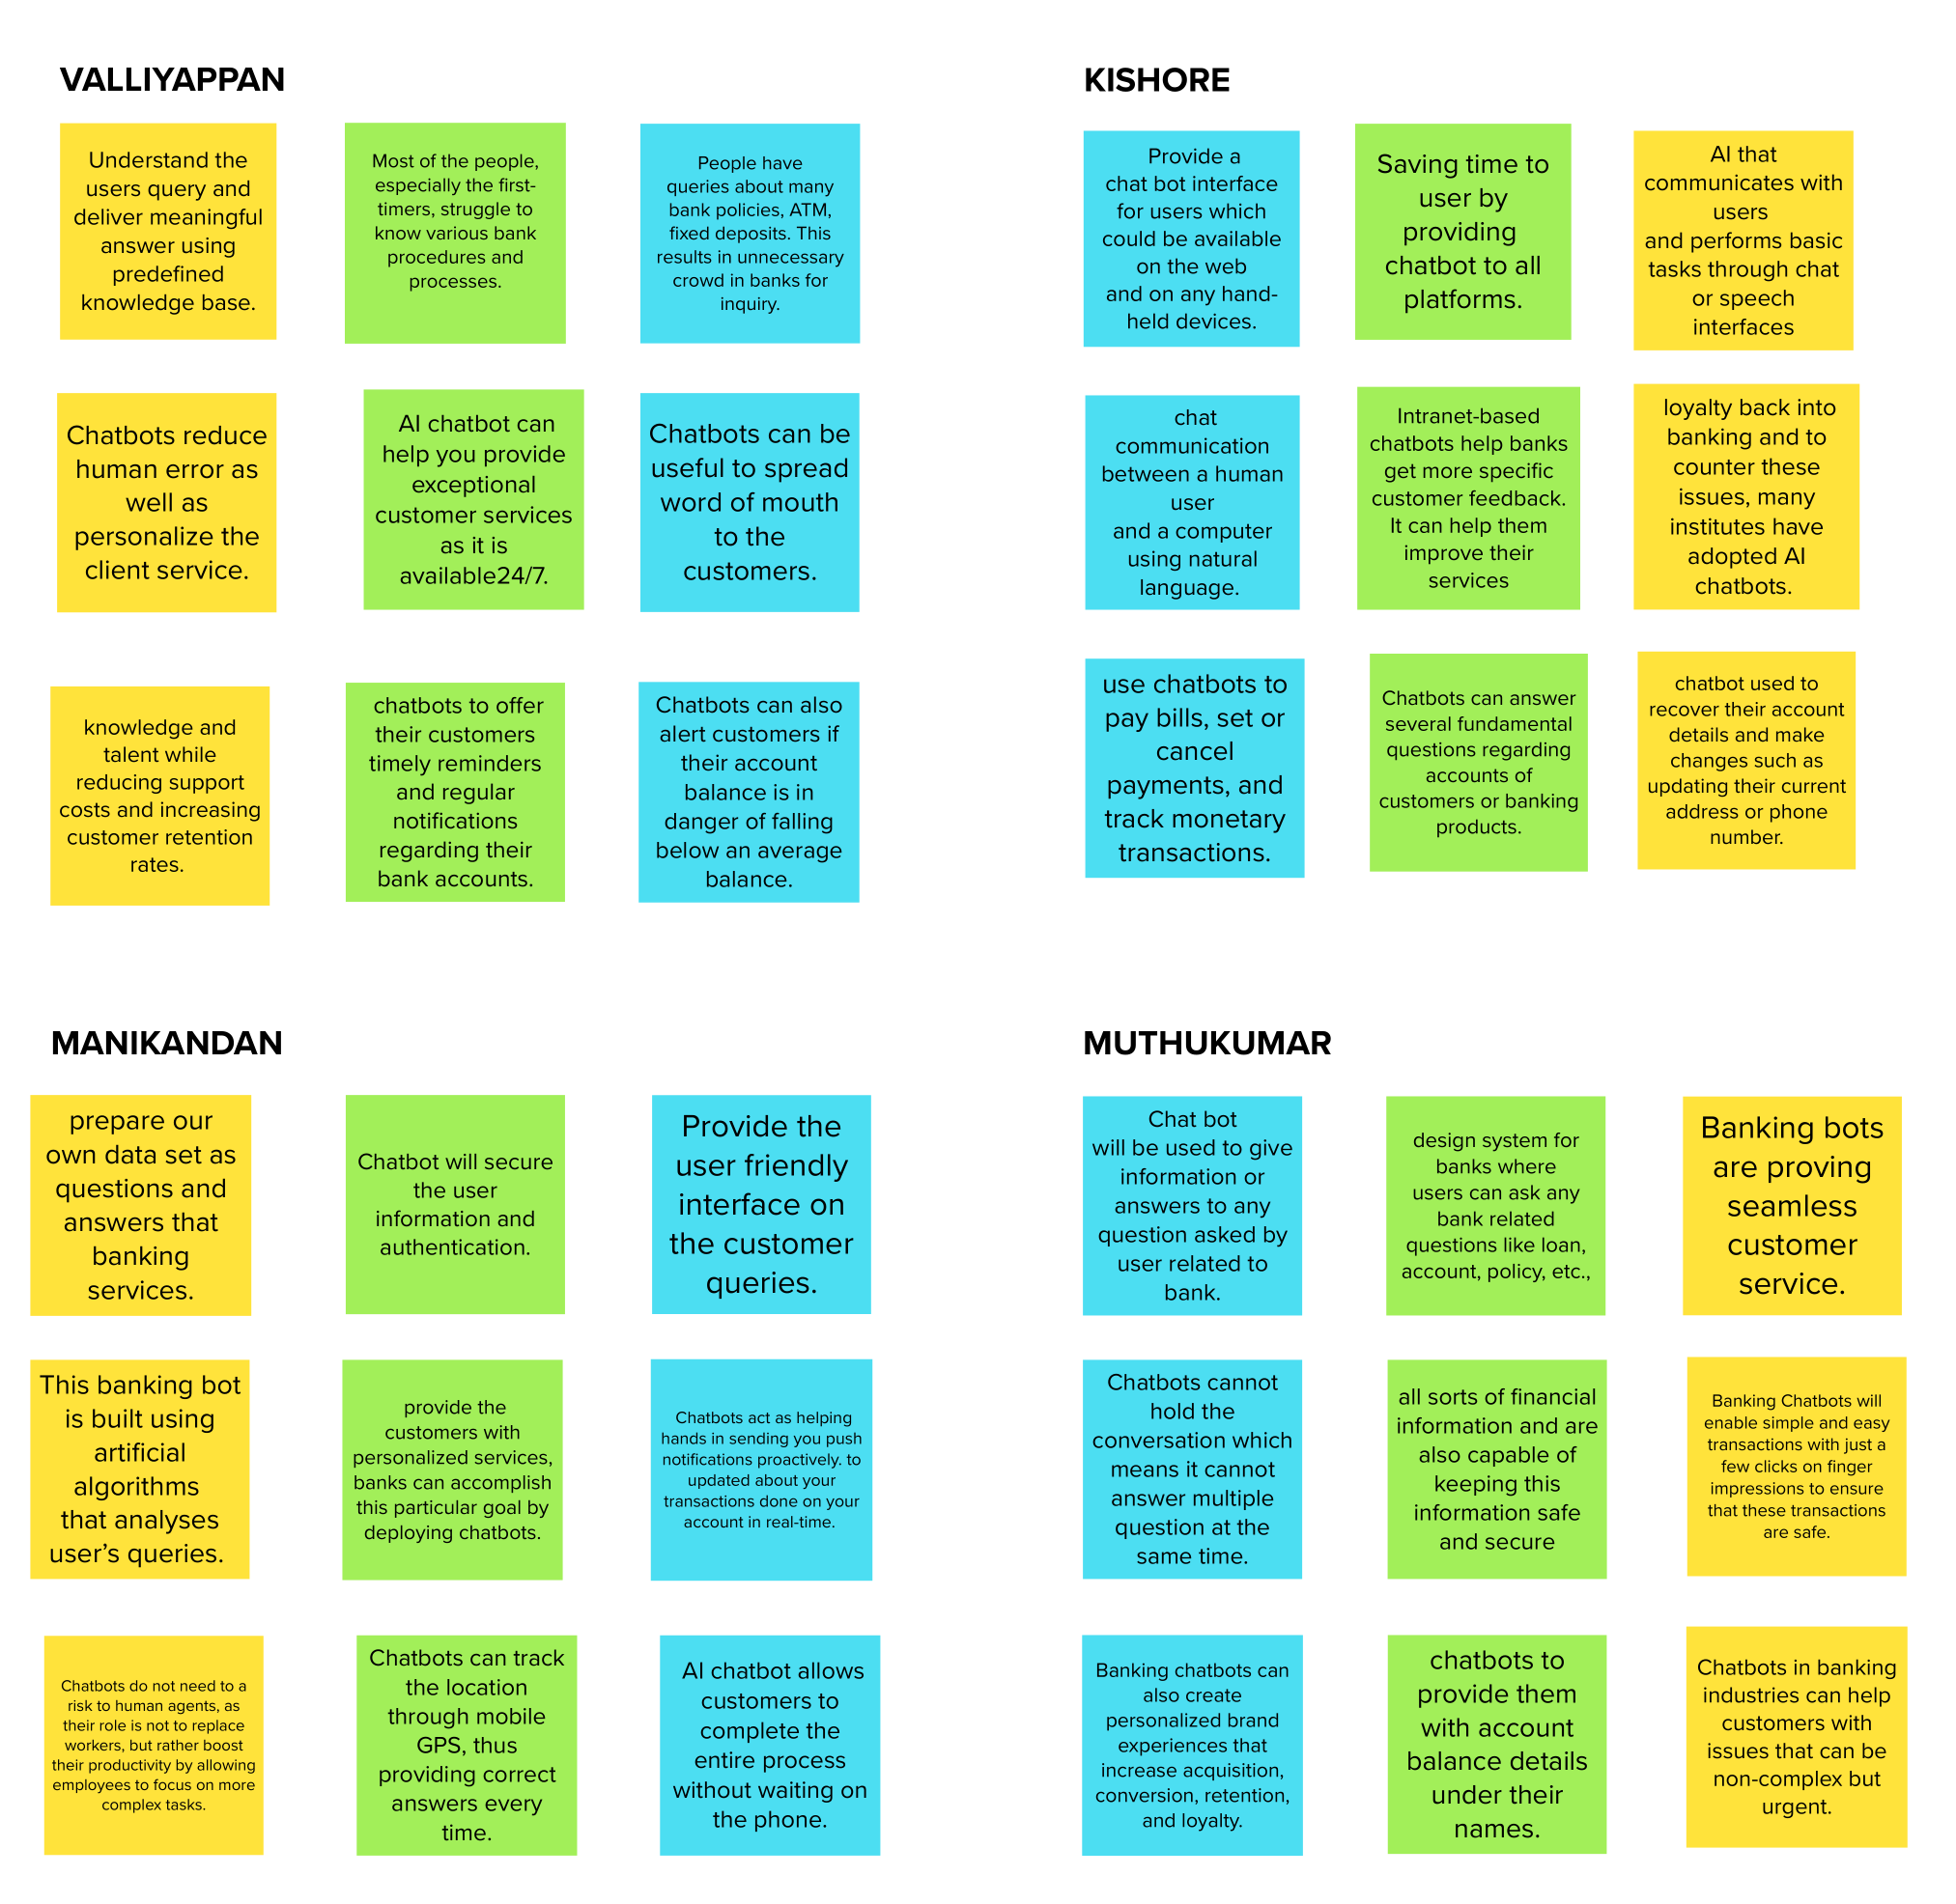
BRAINSTROMING & IDEATION

Slide 12
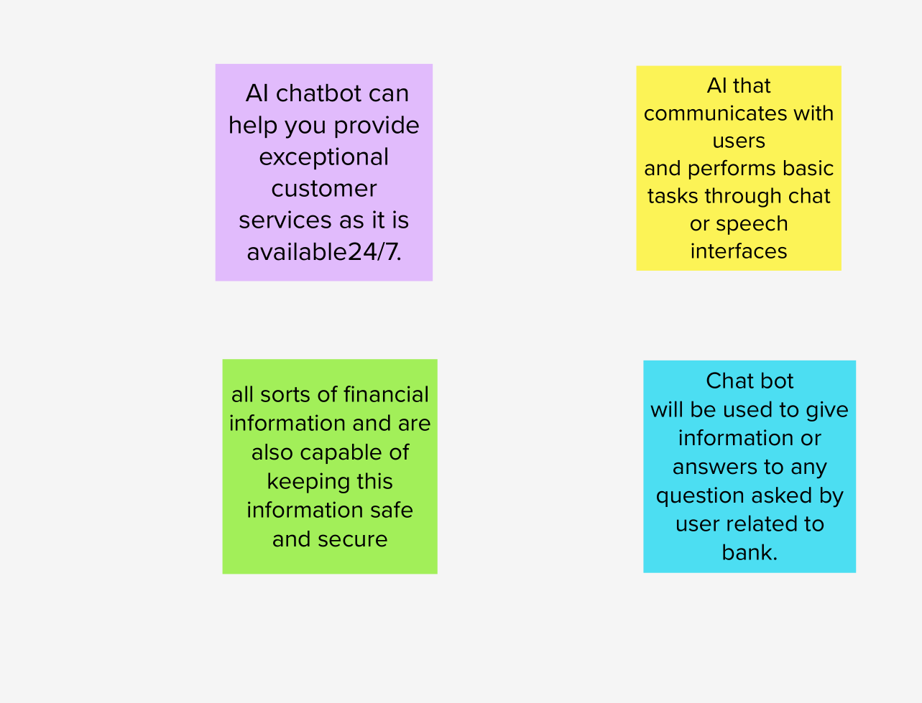
BRAINSTROMING & IDEATION
Choose the best four ideas.

Slide 13
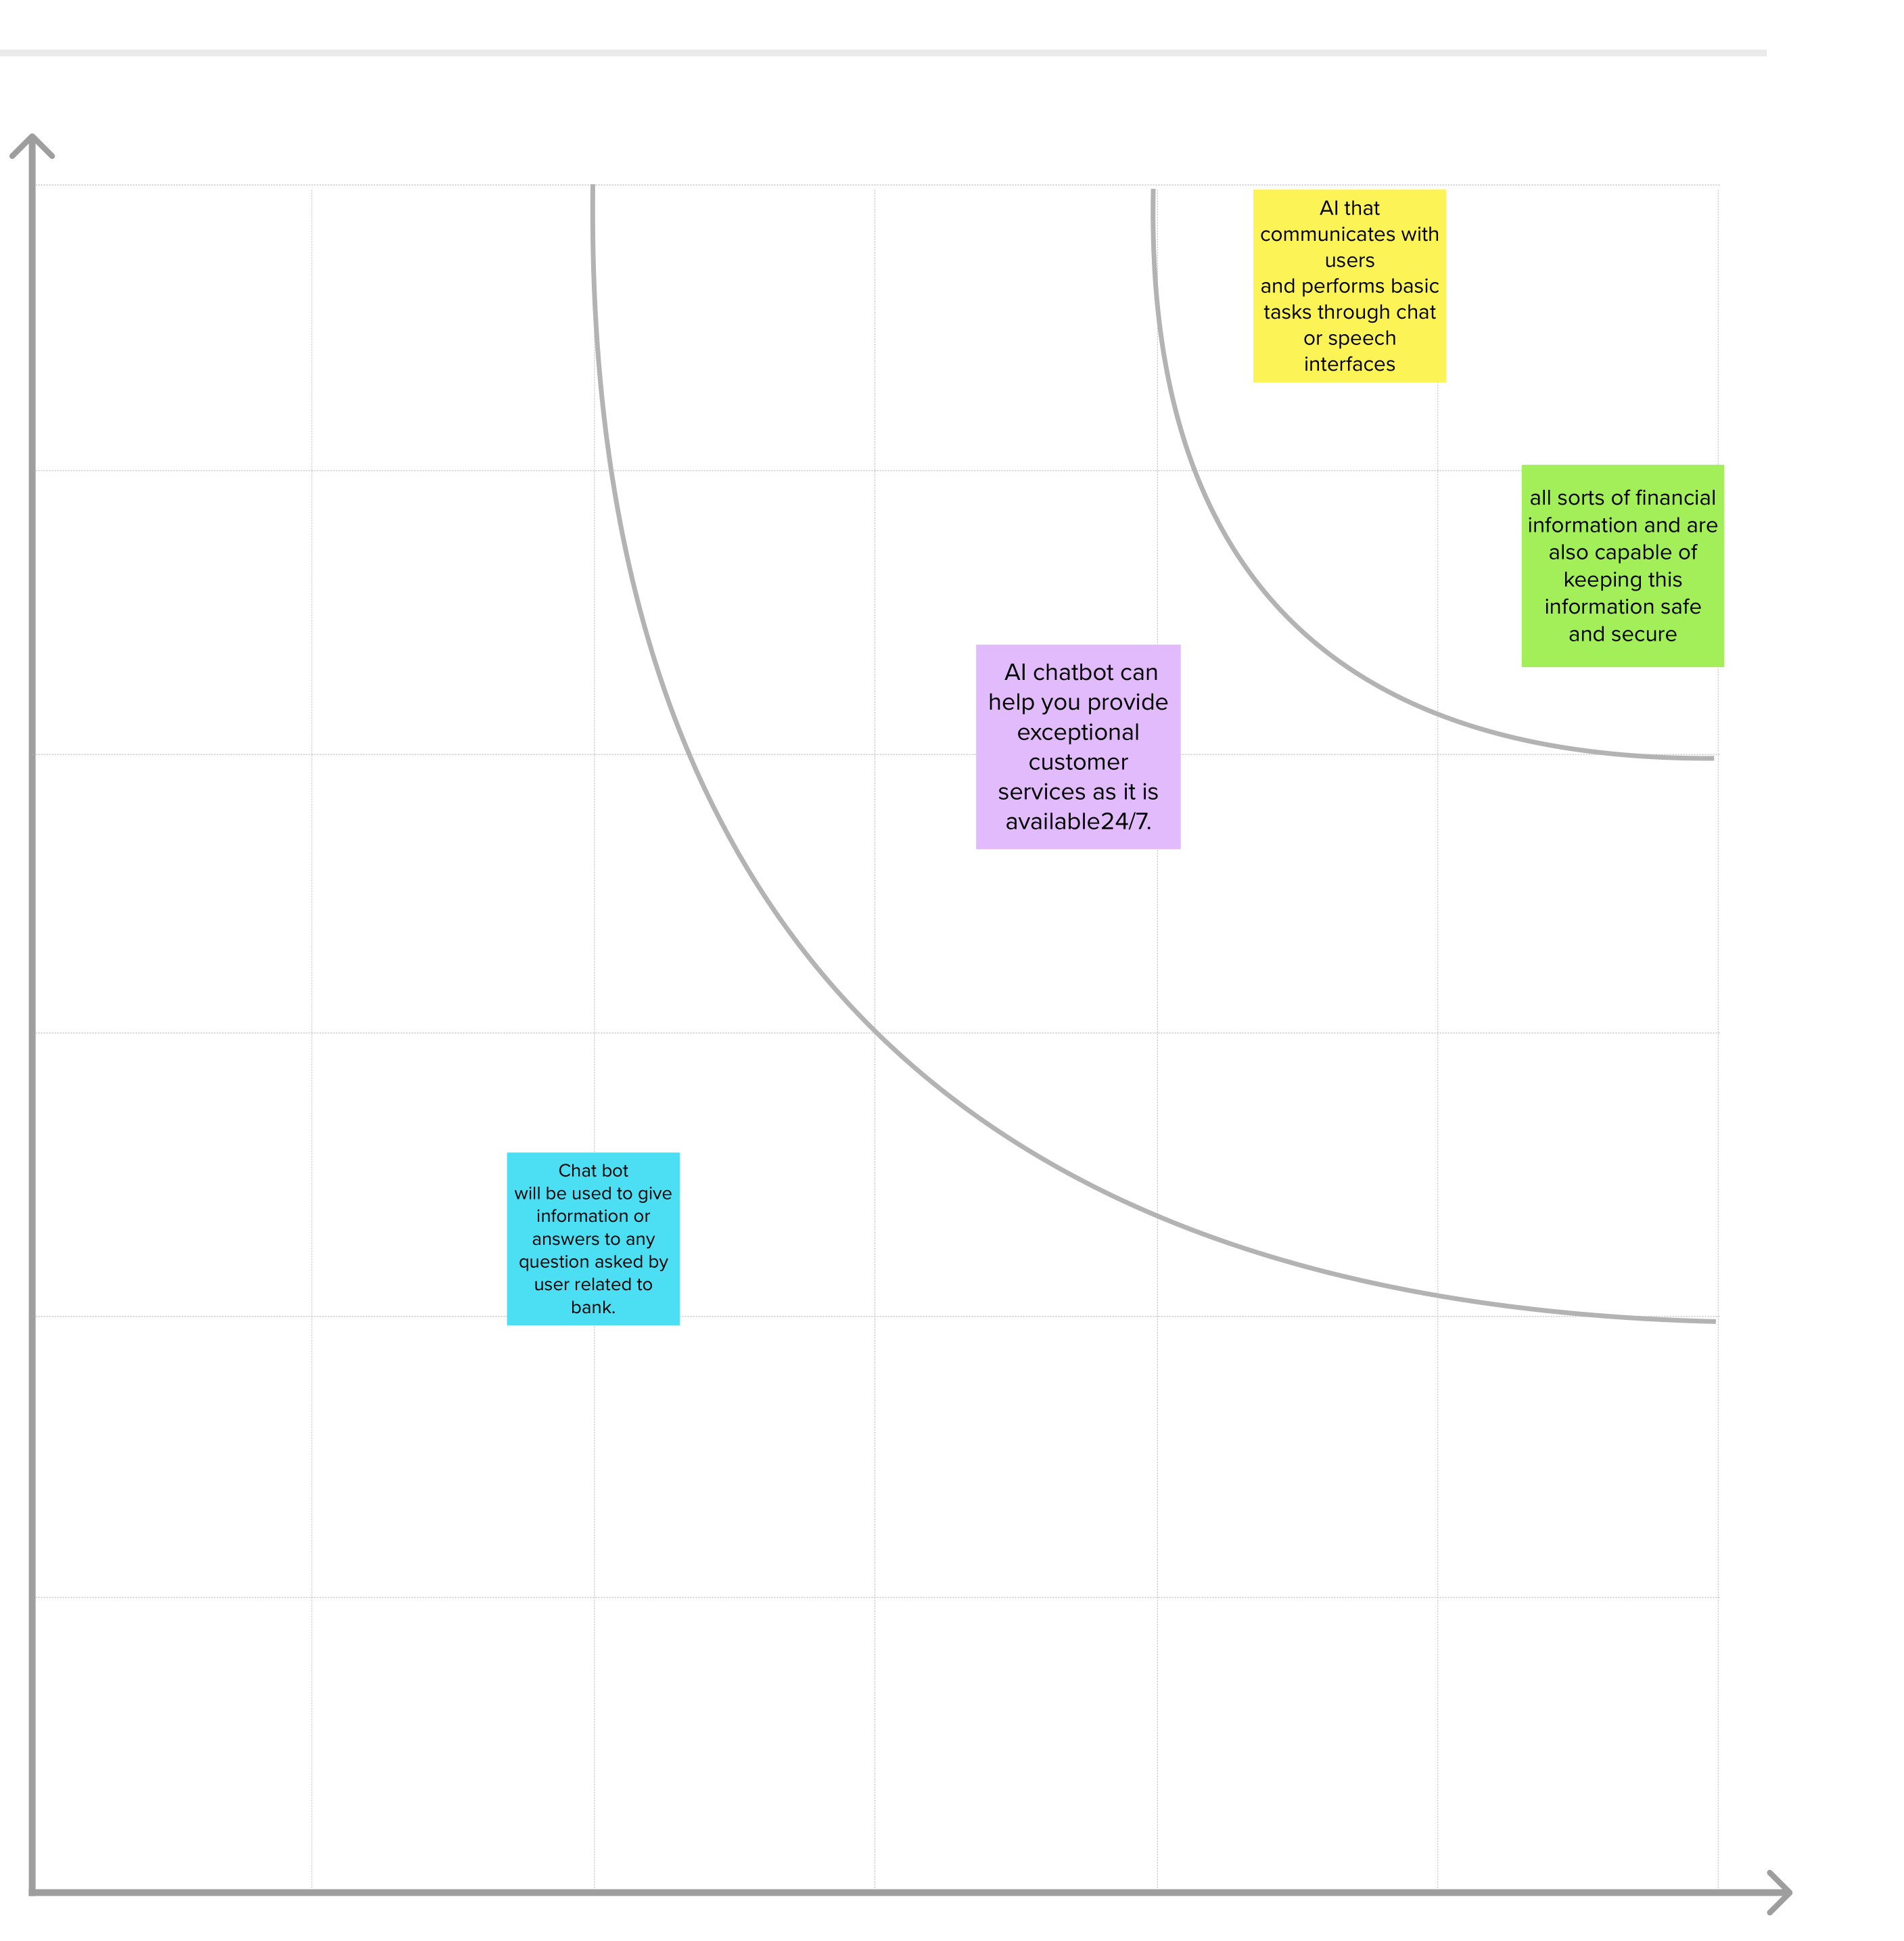
BRAINSTROMING & IDEATION

Slide 14
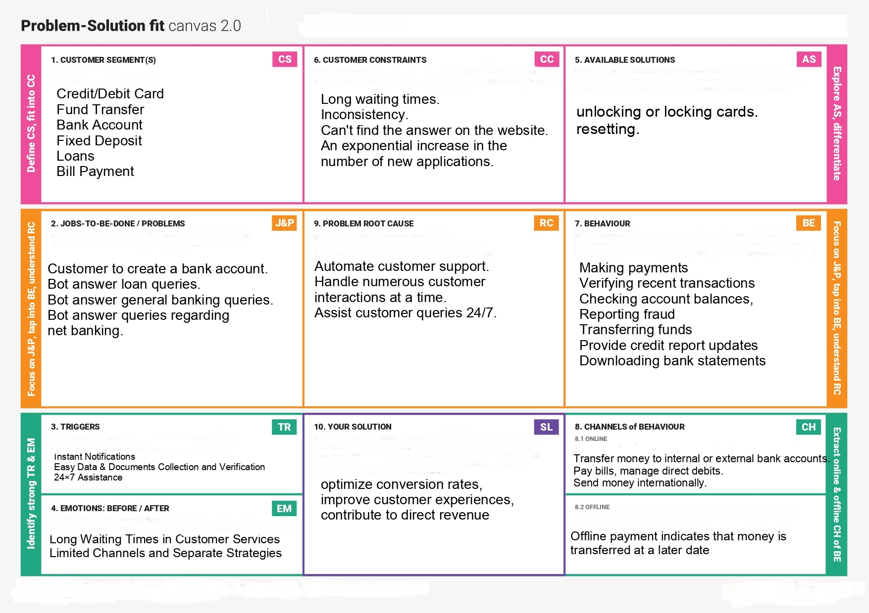
PROBLEM SOLUTION FIT

Slide 15
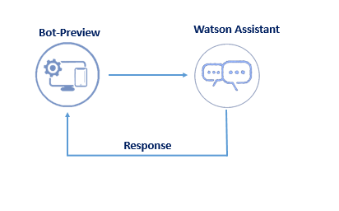
SOLUTION ARCHITECTURE

Slide 16
FUNCTIONAL REQUIREMENT
Creating the Savings account actions
Creating the Current account actions
Creating the loan account actions
Creating the general query account actions
Creating the net banking account actions

Slide 17
NONFUNCTIONAL REQUIREMENT
The system shall handle multiple users inputs, If two or more students are chatting with the bot, none of the students has to wait too long to be answered by the system.
The system should prevent abusive language

Slide 18
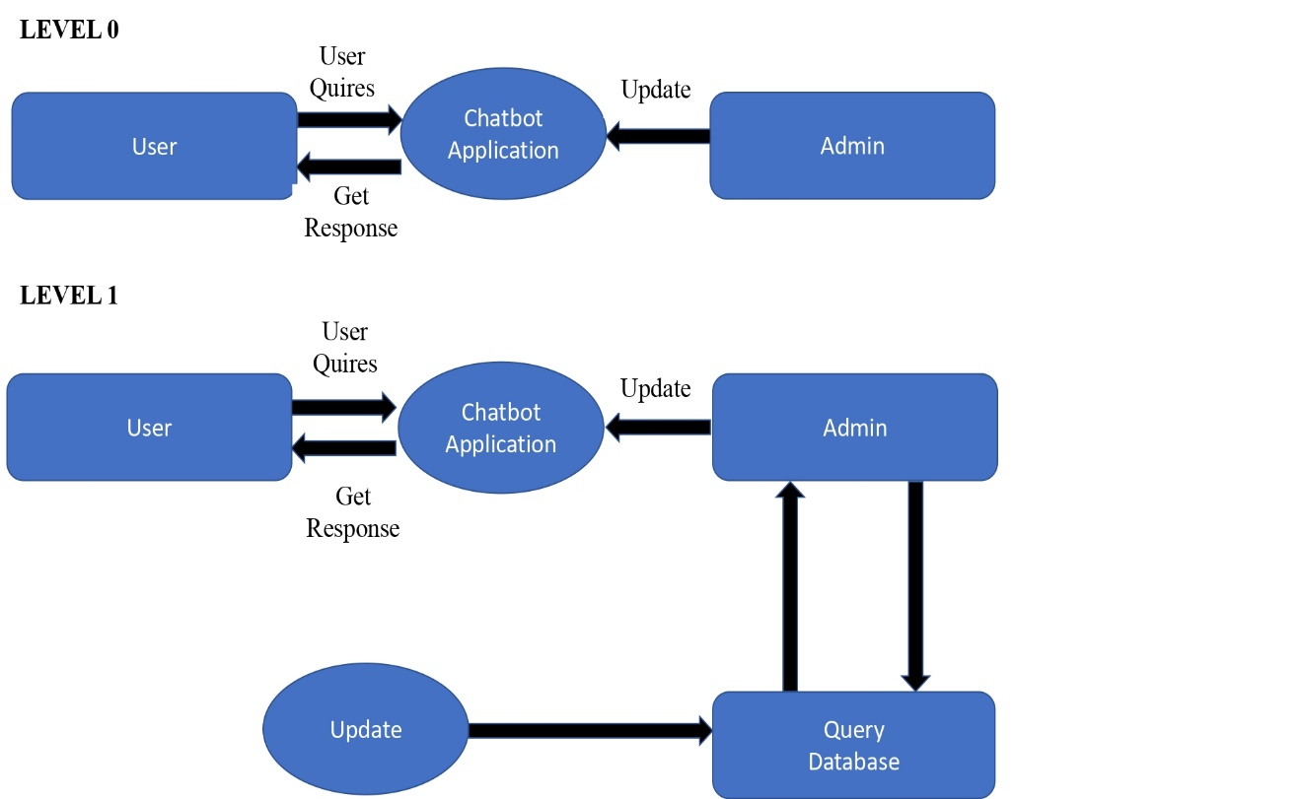
DATA FLOW DIAGRAMS

Slide 19
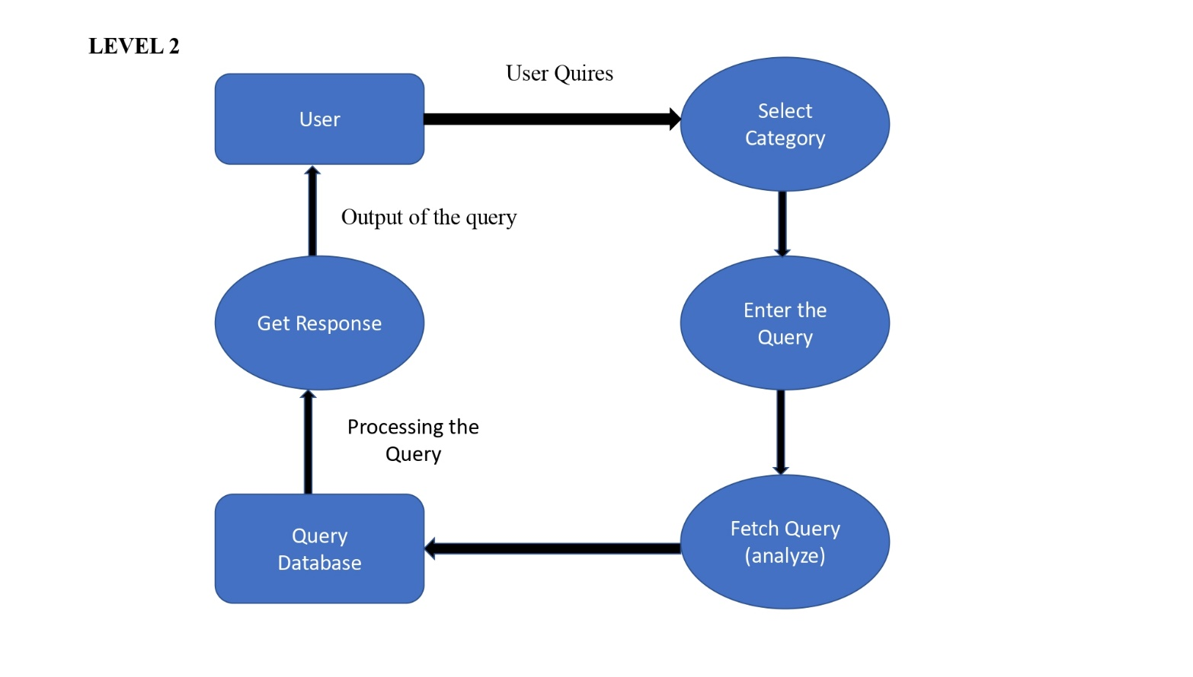
DATA FLOW DIAGRAMS

Slide 20
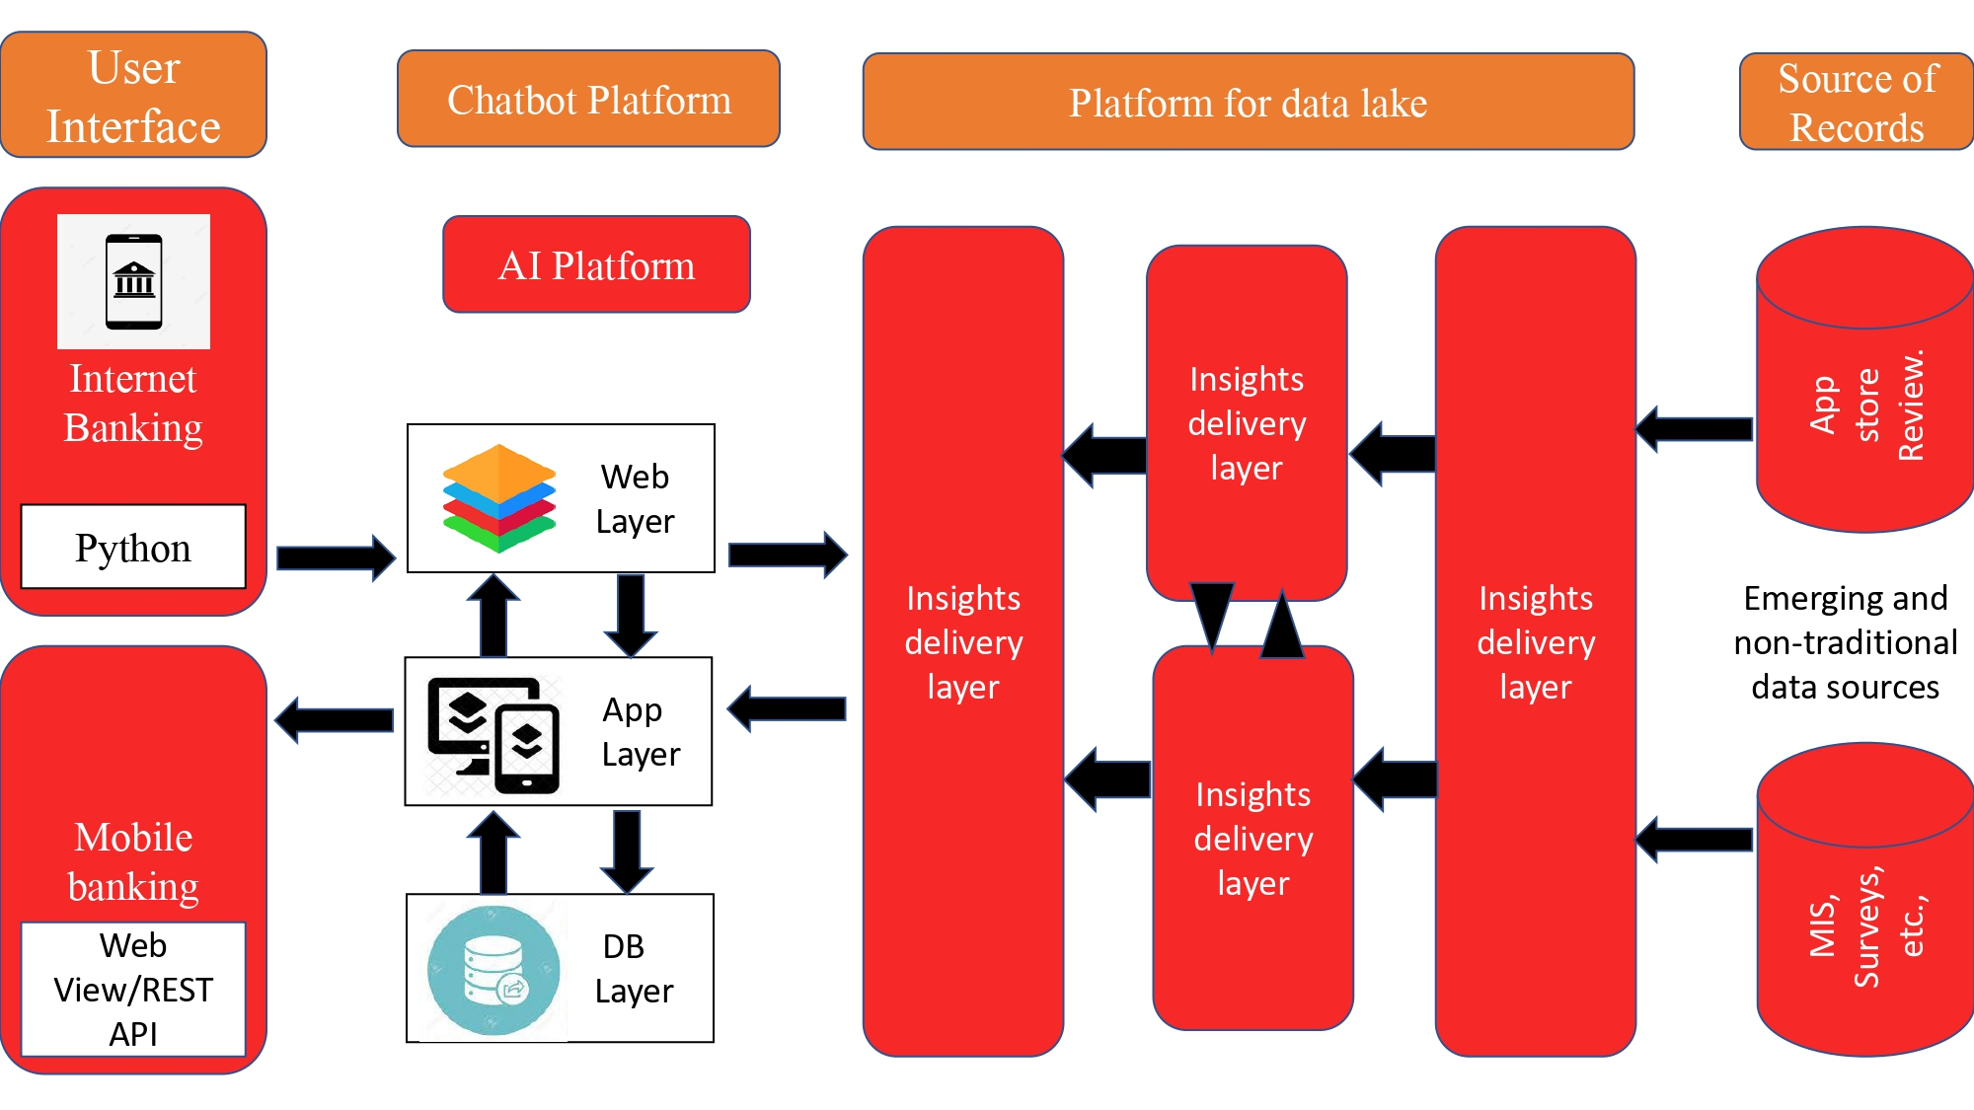
TECHNOLOGY ARCHITECTURE

Slide 21
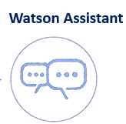


SOFTWARE REQUIREMENTS
Watson Assistant
Visual studio code

Slide 22
PROJECT DEVELOPMENT PHASE
Create IBM Service(sprint 1)
Creating Skills & Assistant for Chatbot
Chatbot Skill Creation (sprint 1)
Creating Savings Account Action (sprint 1)
Creating Current Account Action (sprint 2)
Creating Loan Account Action (sprint 2)
Creating General Query Action (sprint 3)
Creating Net Banking Action (sprint 3)
Creating Assistant & Integrate Flask Web Page
Build Python Code (sprint 4)
Build Html Code (sprint 4)
Run the application (sprint 4)

Slide 23
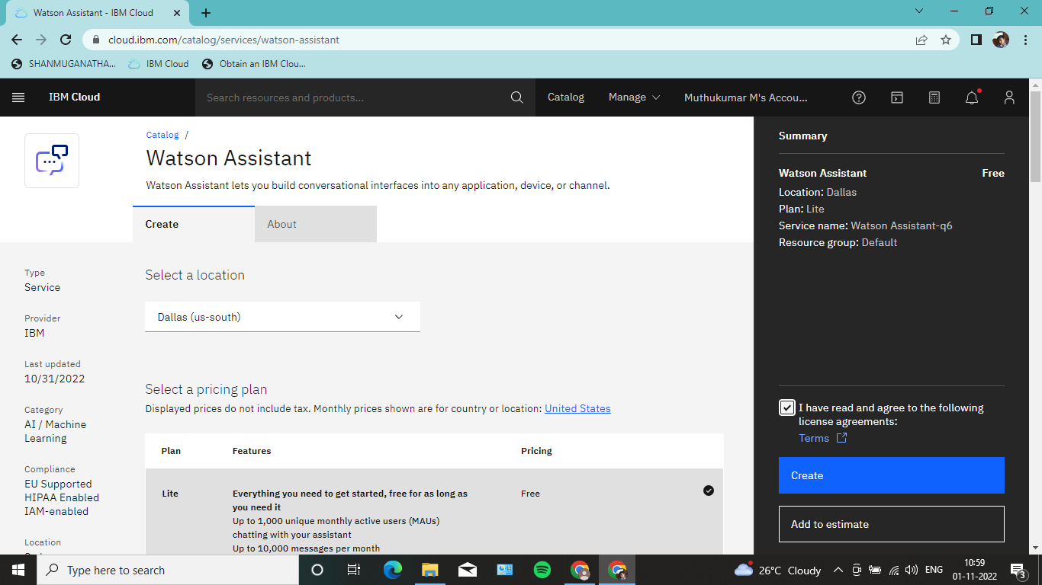
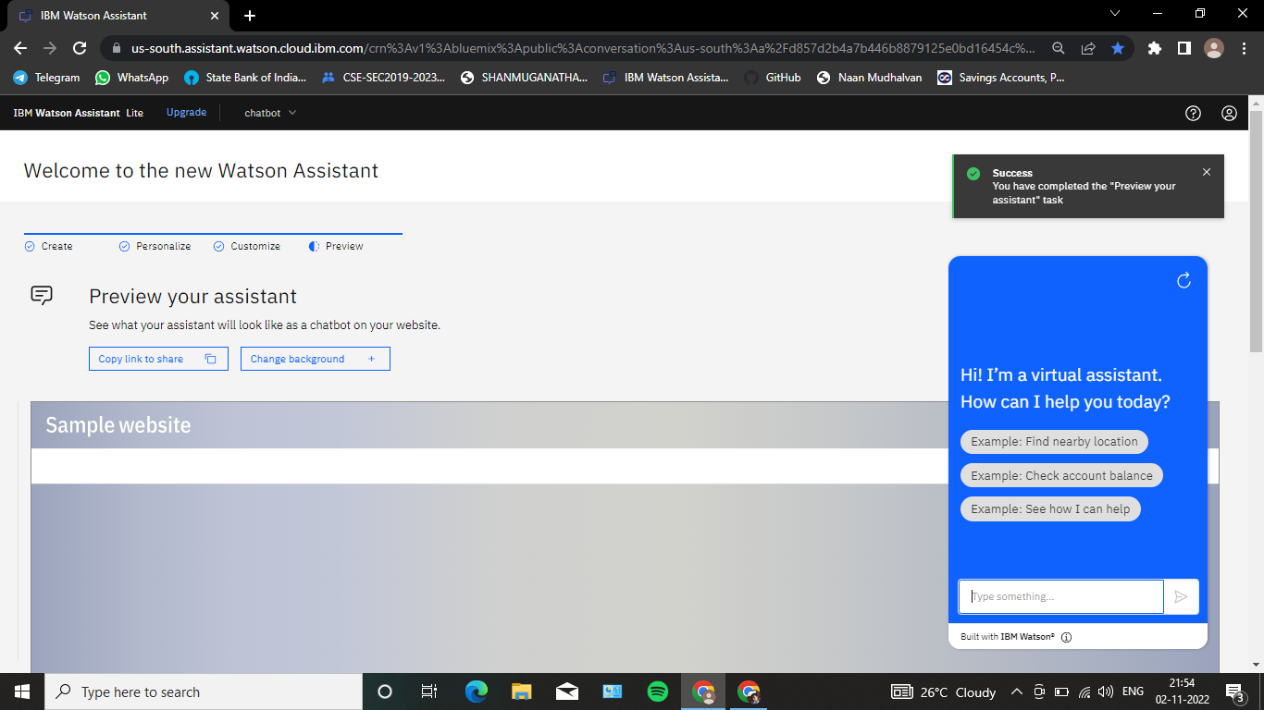
Create IBM services (sprint 1)

Slide 24
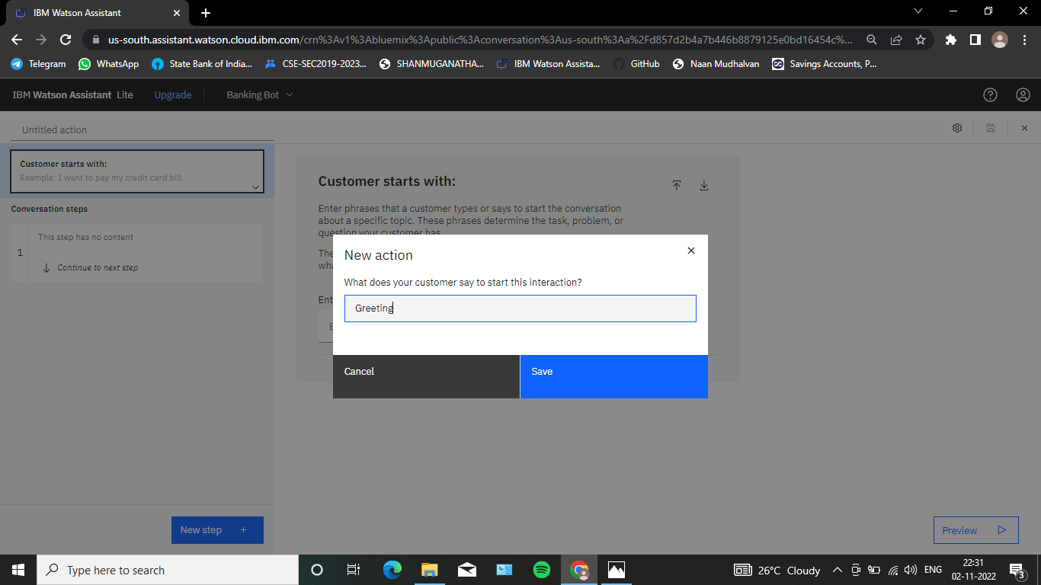

Chat bot Skill creation (sprint 1)

Slide 25
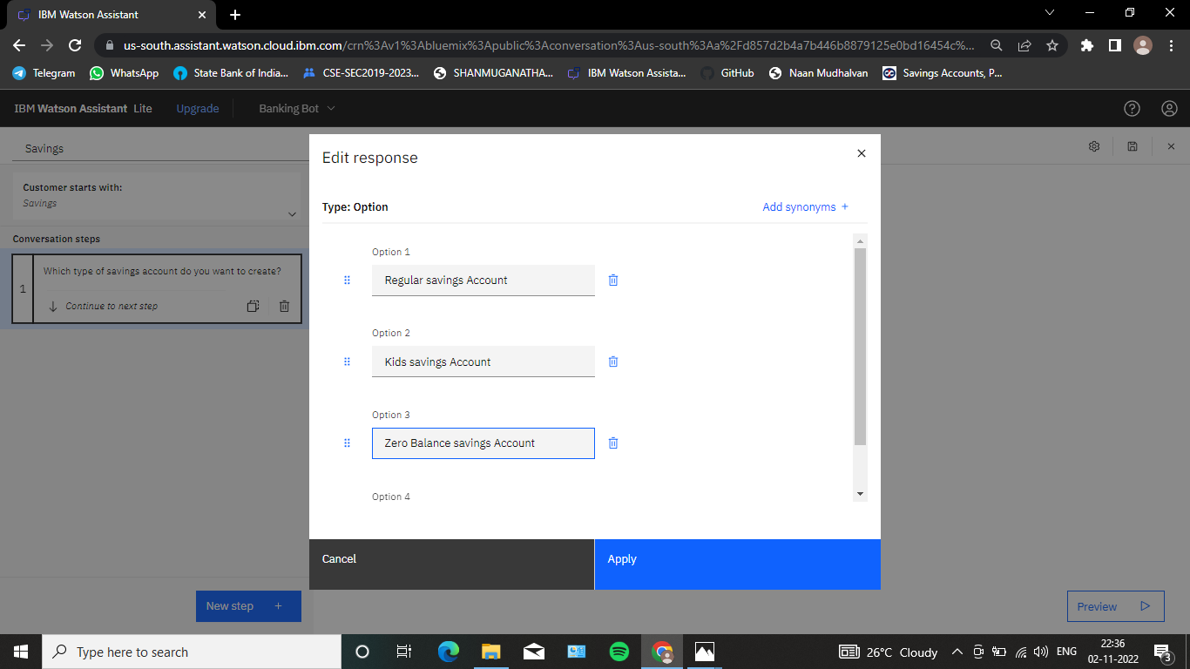
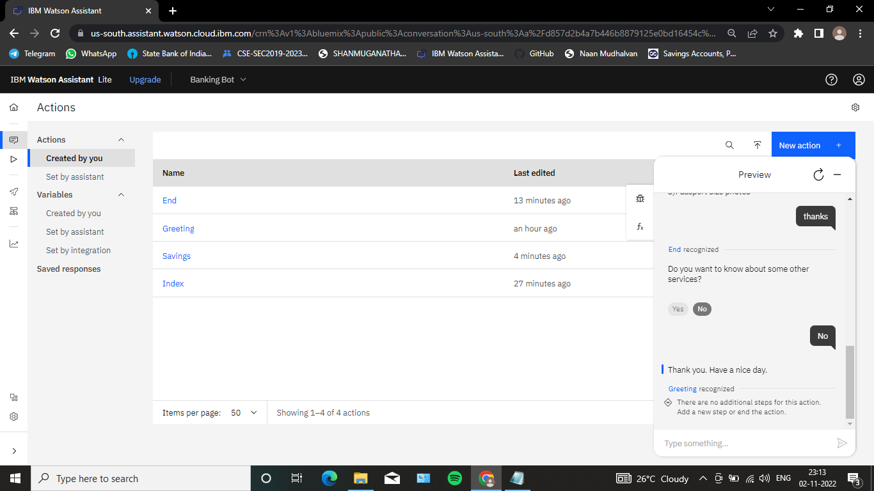
Create Savings account action (sprint 1)

Slide 26
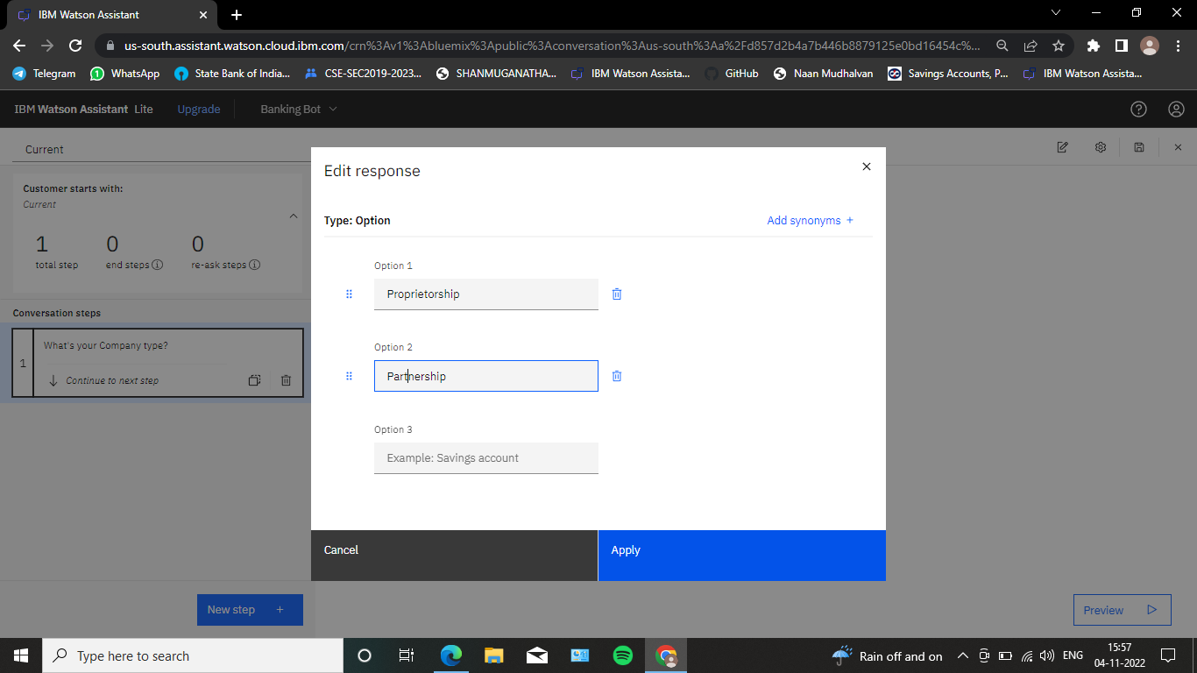
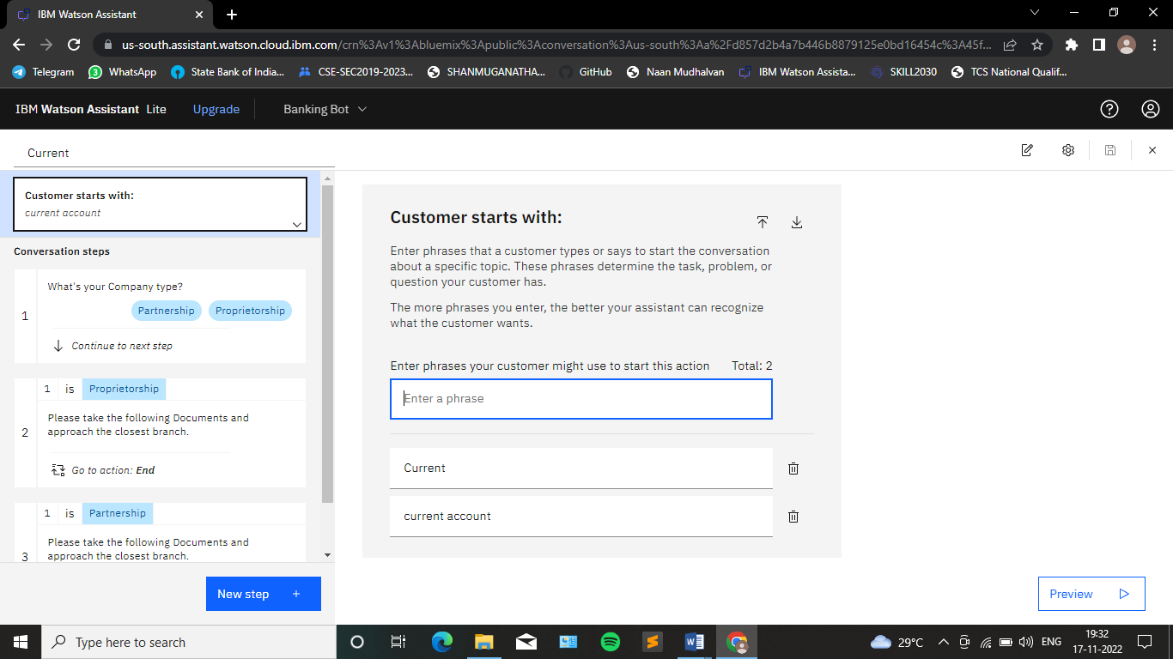
Create Current account action (sprint 2)

Slide 27
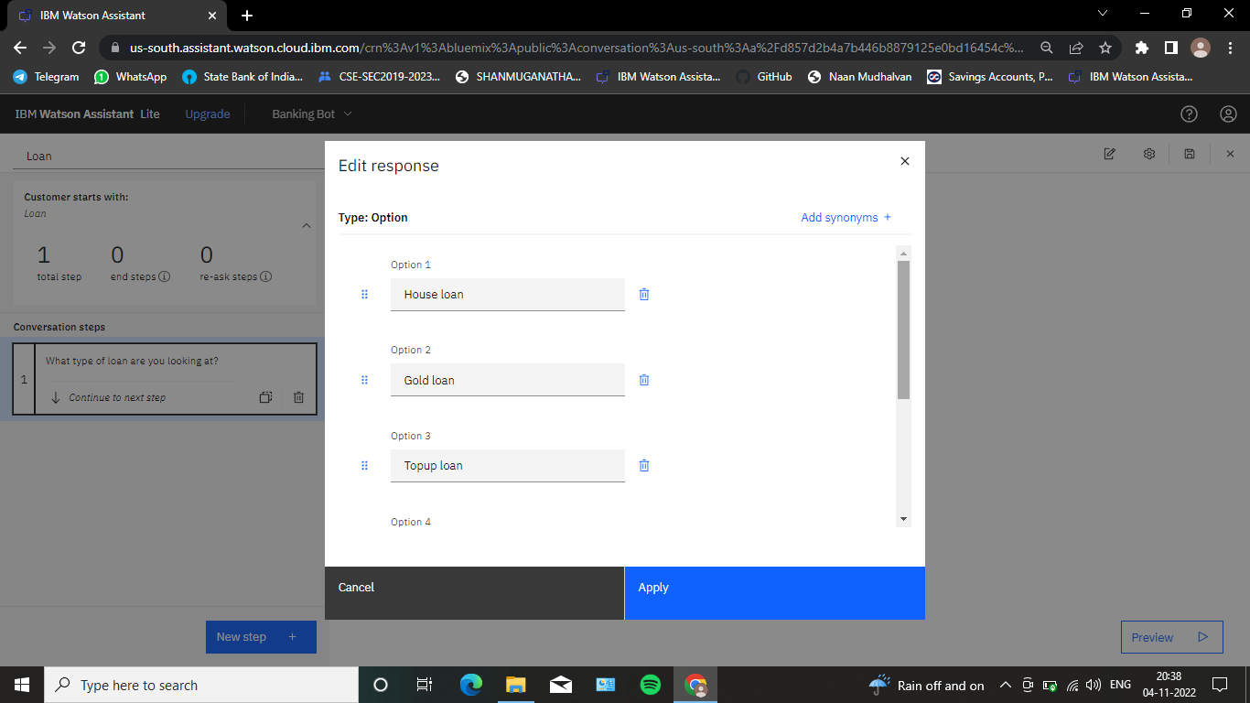
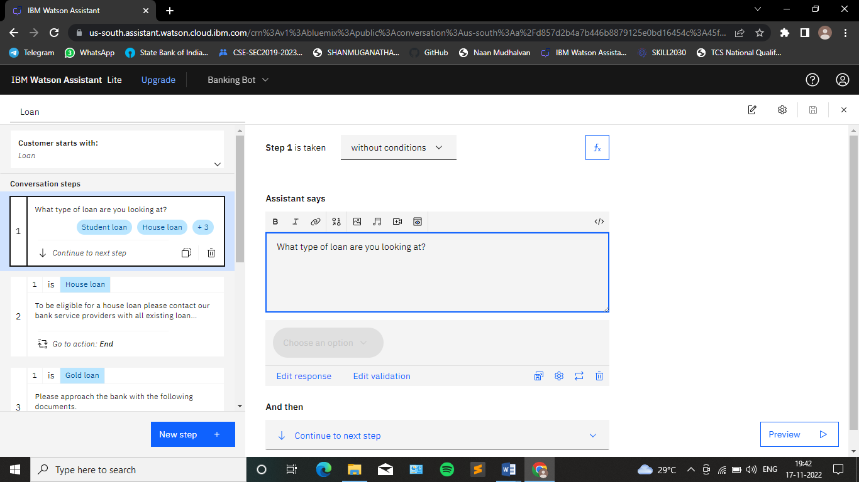
Create Loan account action (sprint 2)

Slide 28
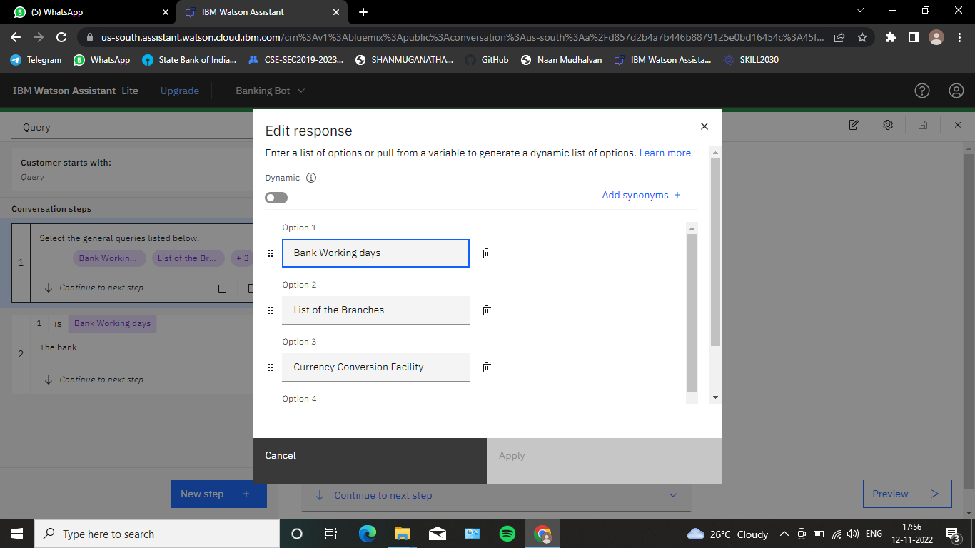
Create General Query actions (sprint 3)

Slide 29
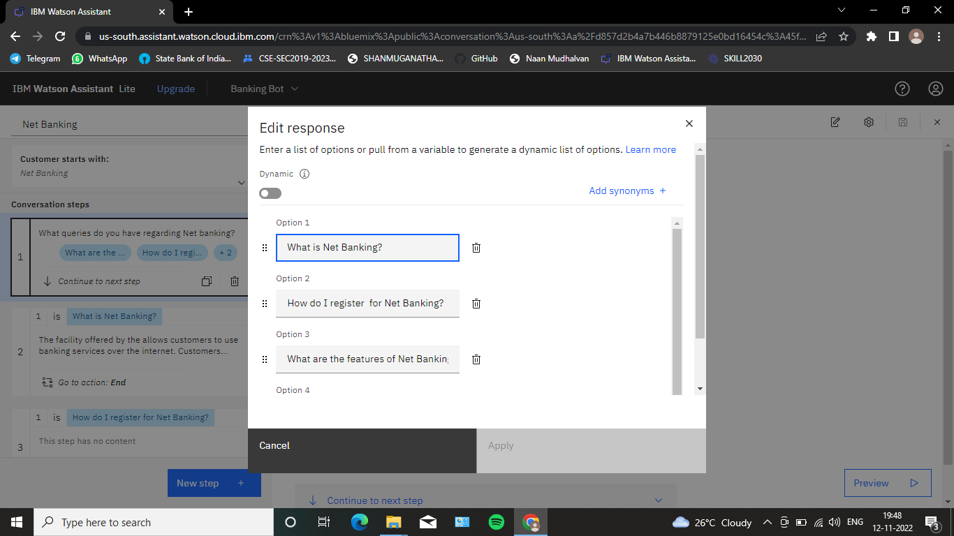
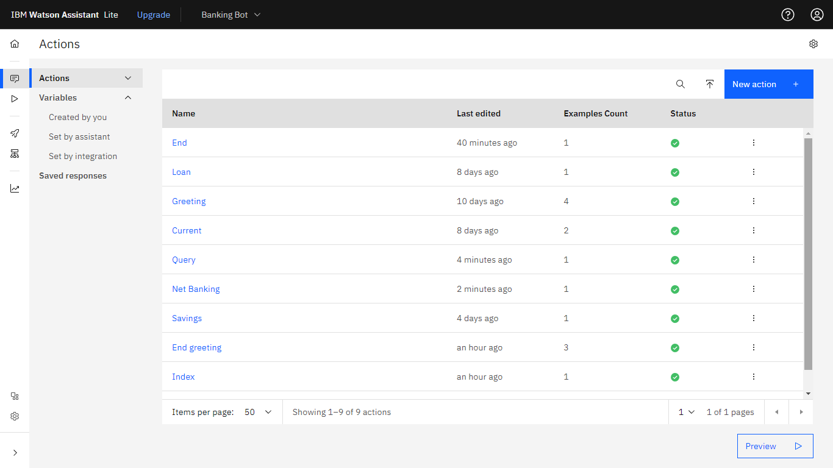
Create Net Banking account action (sprint 3)

Slide 30
sprint 4
Creating Assistant & Integrate with Flask Web Page
Build Python Code
Build Html code
Run the application.

Slide 31
PREVIEW

Slide 32
PREVIEW

Slide 33
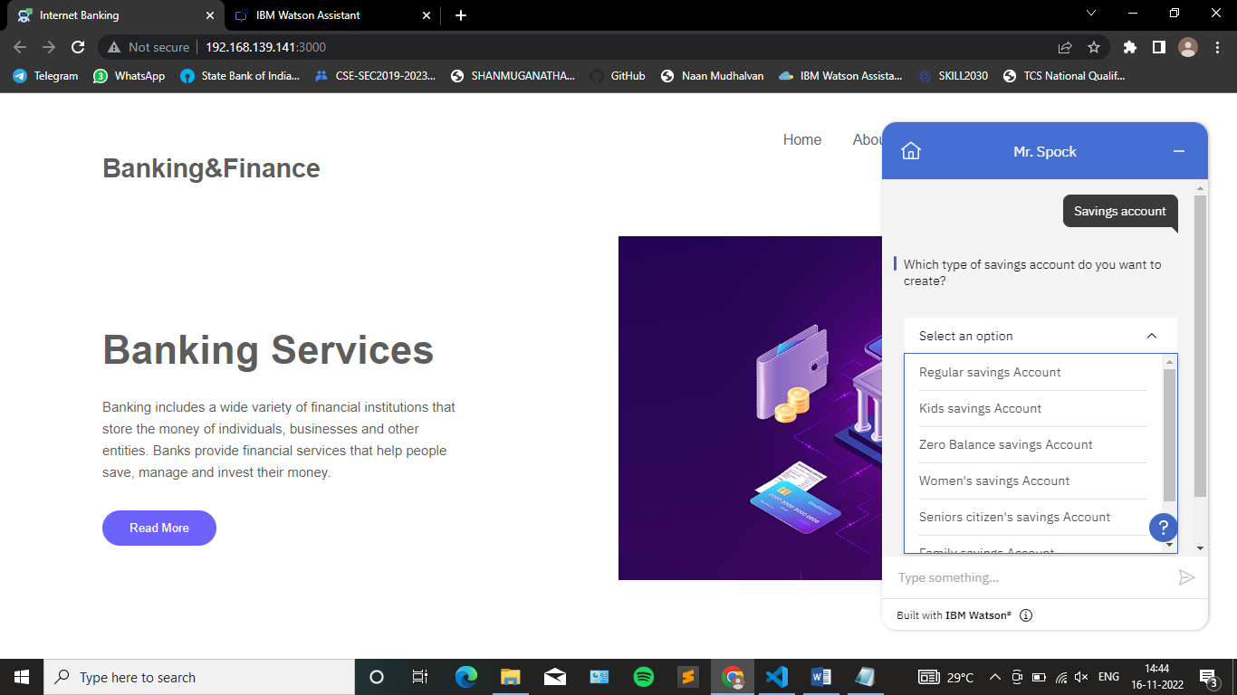
PREVIEW

Slide 34
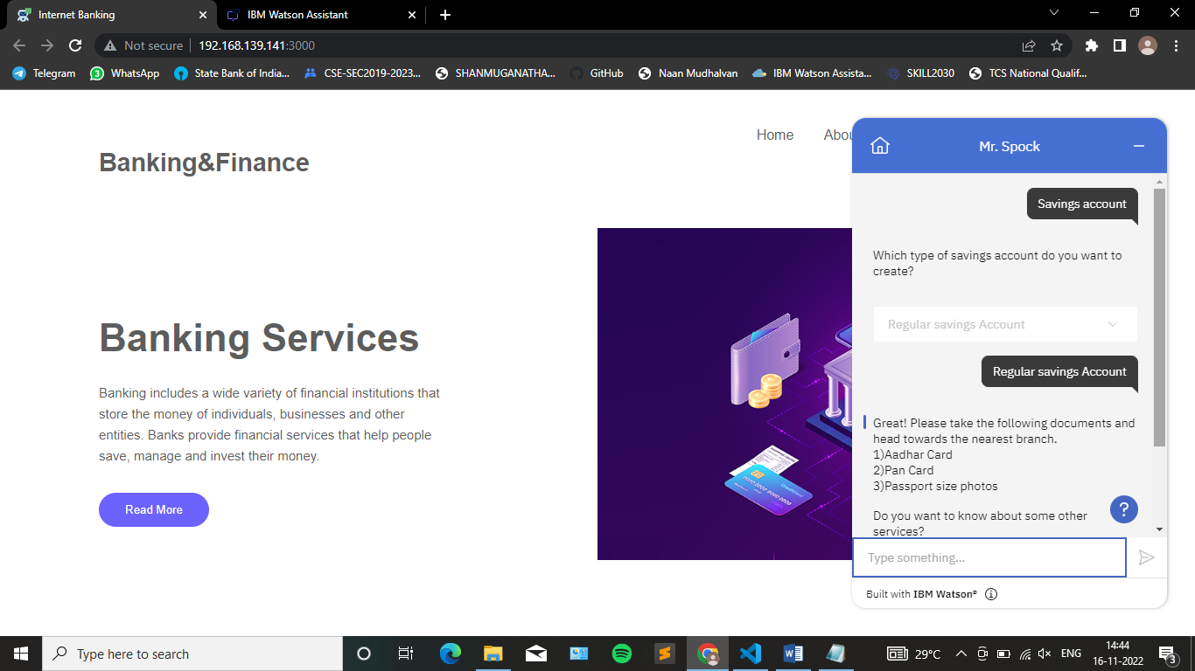
PREVIEW

Slide 35
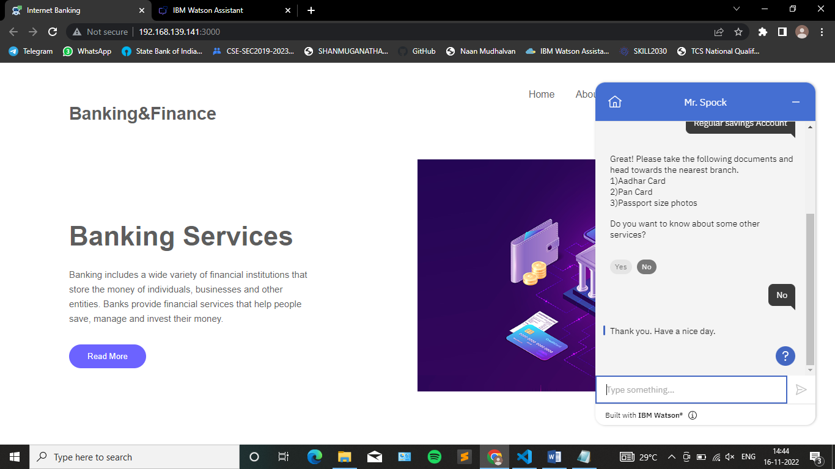
PREVIEW

Slide 36
CONCLUSION
It is difficult to get the information on a single interface without complications of going to multiple windows and multiple banks.
The banking inquiry chat bot aims to remove this difficulty by providing a common end user-friendly interface to solve queries of customers as well as bank employee.
The purpose of a chat bot system is to simulate a human conversation

Slide 37


